Slide 1
F1nance – Use Case Diagram

Slide 2
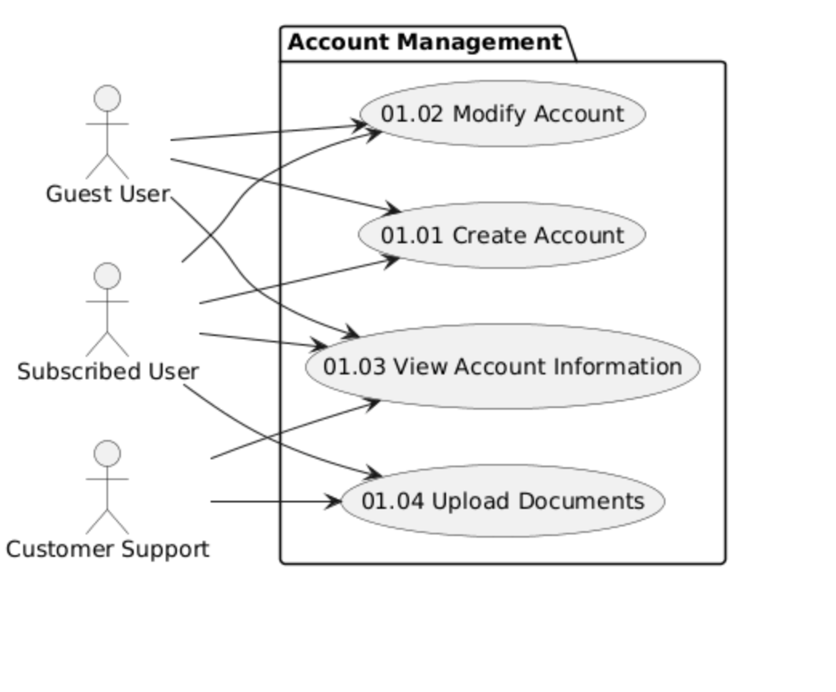
Account Management

Slide 3
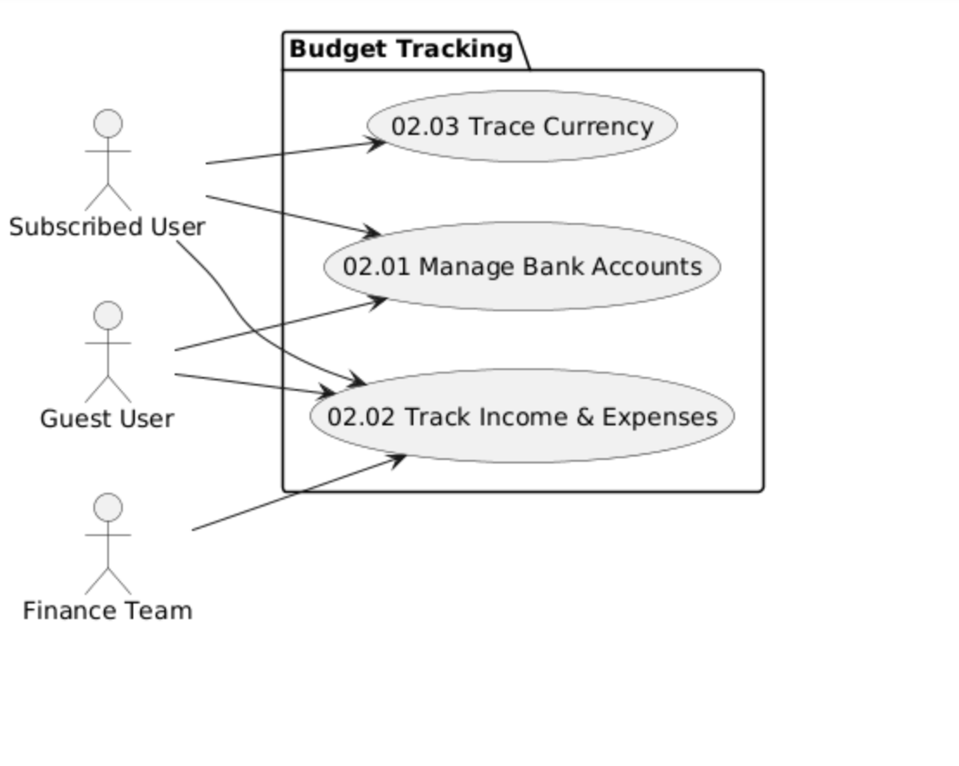
Budget Tracking

Slide 4
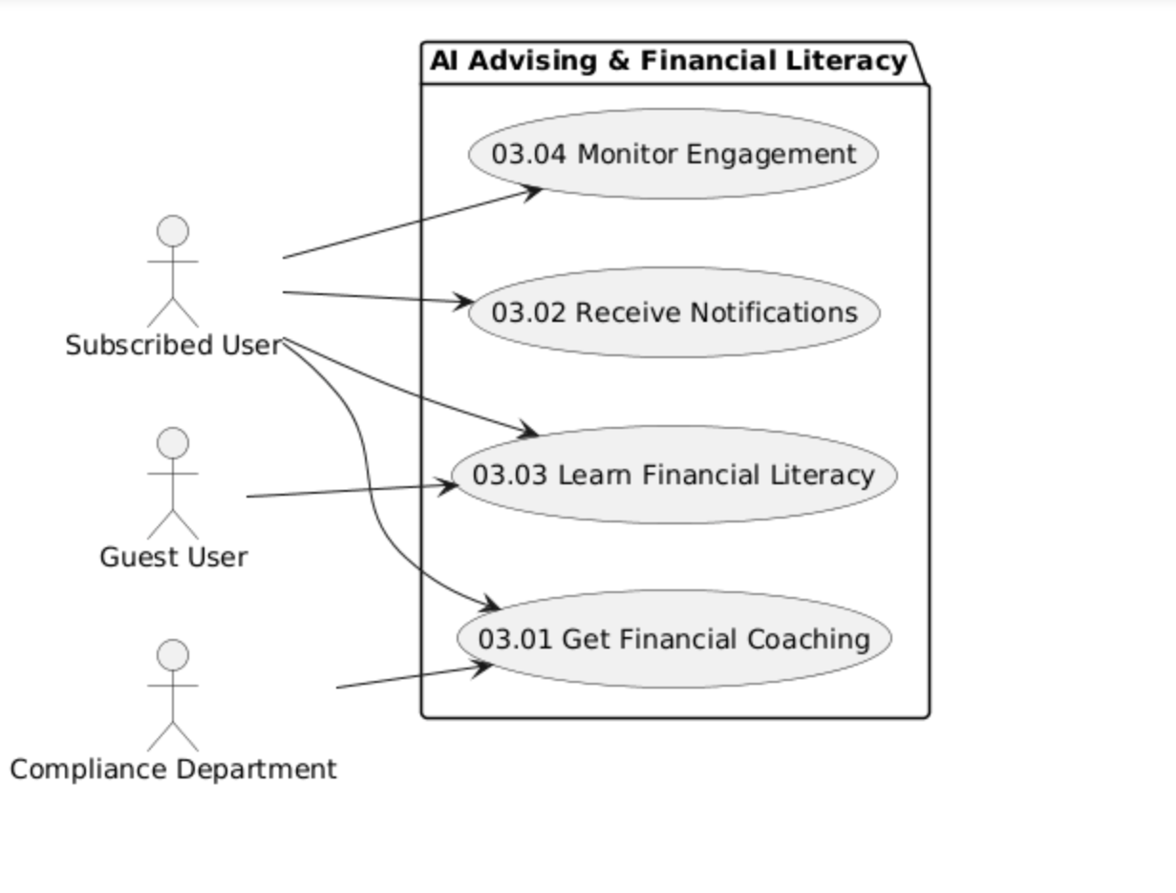
AI Advising & Financial Literacy

Slide 5
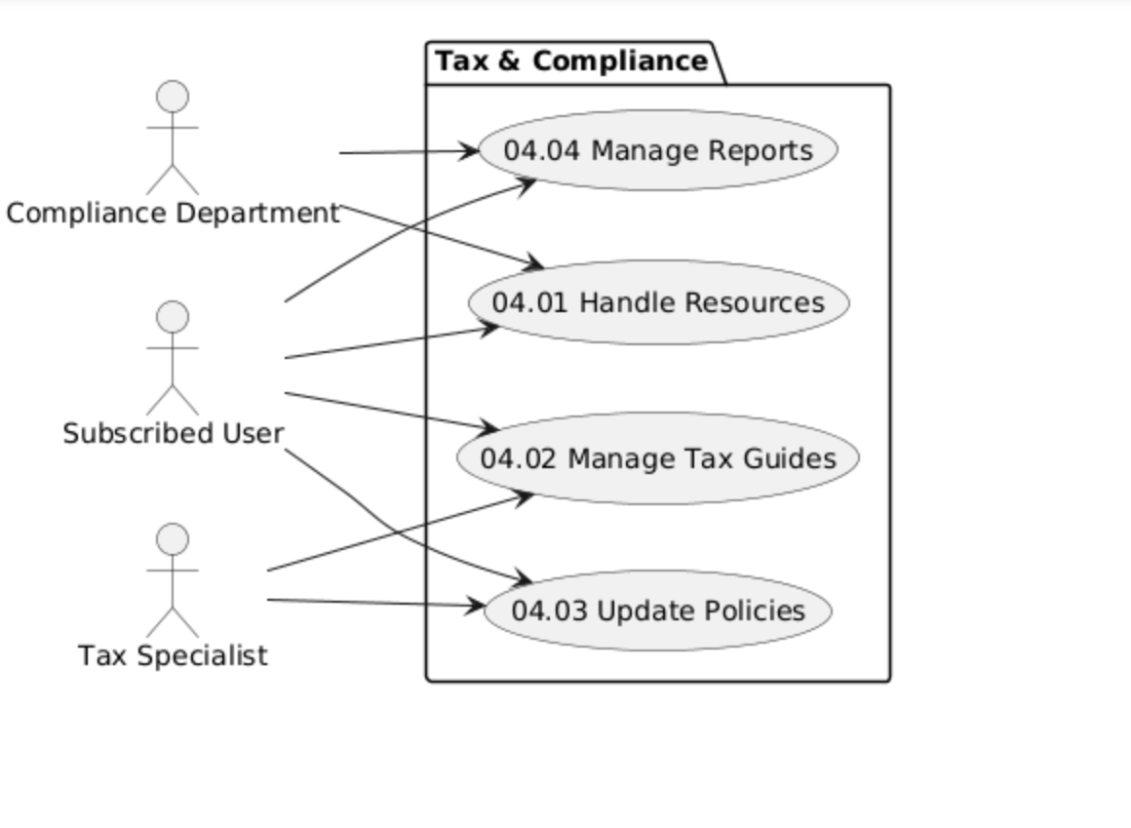
Tax Compliance

Slide 6
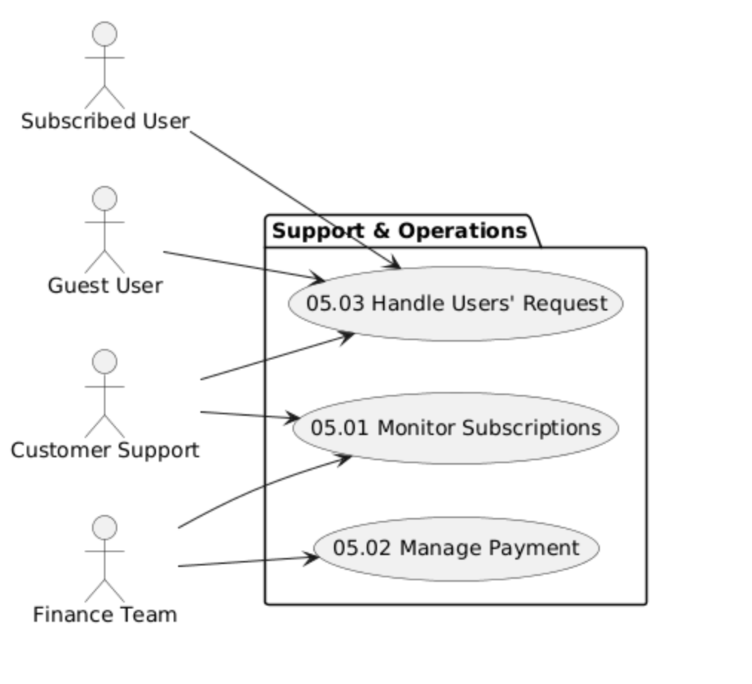
Support & Operations

